Slide 1
Stronger Together Partnership
Building Better Opportunities: Berkshire West
Project Manager:
Janet Meehan, Reading Borough Council
8 November 2018

Slide 2
Overview
Value: £1.3M to support 334 (434) participants aged 25 and over into work or closer to the labour market
Geography: West Berkshire
(1 of 3 BBO projects in the Thames Valley Berkshire LEP area)
Timeline : 1st Oct 2017 – 30 June 2020
Lead: Reading Borough Council, plus
12 equal partners: (Charity, social enterprise, higher education, local authority)
One partner particularly focussed on employer engagement

Slide 3
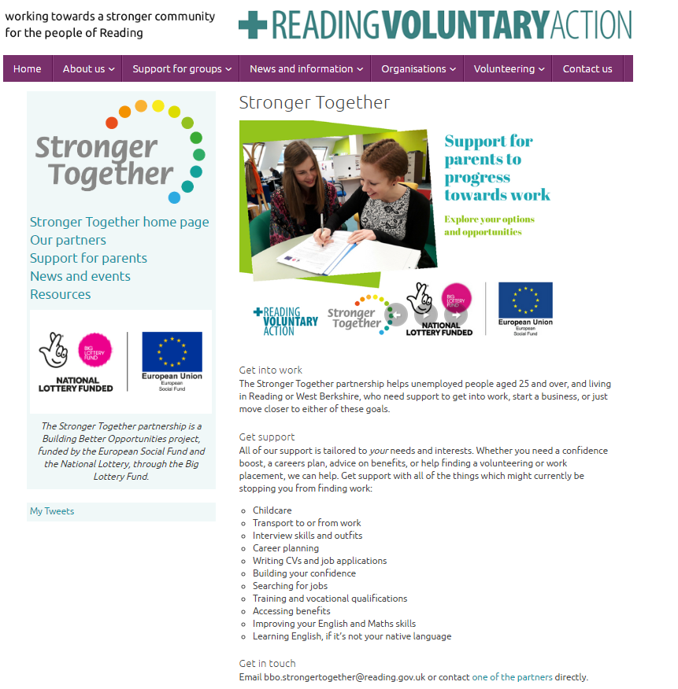

Slide 4
Learning
From the start …
Due diligence and ‘top tips’
Non-eligible costs
Implementation and delivery
Partnership working
Administration and compliance
Shifting sands
Motivation
Referrals
Participants

Slide 5
Support (example)

Slide 6
Learning
Themes for this event
Engagement of hard to reach groups
Employer engagement
Co-production/involving participants
Cross cutting themes

Slide 8
Case studies
Partners
Participants

Slide 9
Moving forward
Re-profiling
Sharing our own learning
Developing case studies
Referrals

Slide 10
Stronger Together Partnership
Any questions?

